Slide 1
Reporting Threats of Violence

Slide 3
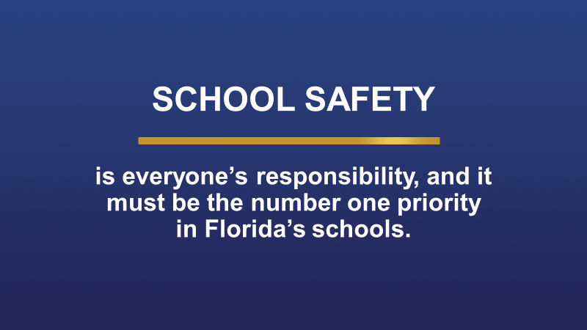

Slide 4
What should I report?

Slide 7
Who should I report threats or concerning behaviors to?

Slide 8
All staff shall immediately report threats of violence and concerning behavior to school administration (Principal/Assistant Principal).

Slide 9
What happens after I report a threat or concerning behavior?

Slide 10
A school-based multidisciplinary team will review reported threats of violence and take appropriate action. The team will establish interventions to ensure the safety of all students and staff.

Slide 11
If a parent or student wants to report threats or concerning behavior anonymously, where should I direct them?

Slide 12
Fortify FL is an anonymous reporting tool available to students and community members for the purpose of reporting anonymous threats. Staff members should report concerns immediately to administration. Fortify FL should not be used by staff members to report threats of violence.
Fortify FL may be used for after-hours issues if administration is otherwise unreachable. Imminent threats of violence should be reported to law enforcement immediately.

Slide 13
If you have additional questions, please reach out to your School Based Threat Management Team or administration for assistance.

